Slide 1
Feasibility of Beam Reinforcement Optimization for Practical Application
Advisor : Prof. K.C.Chang
Presenters : You-Ran Nai
Notes:
Try 講清楚脈絡

Slide 2
Outline
Part 2
Part 4
Methodology
Seismic Verification
Part 1
Part 3
Objective
Condition

Slide 3
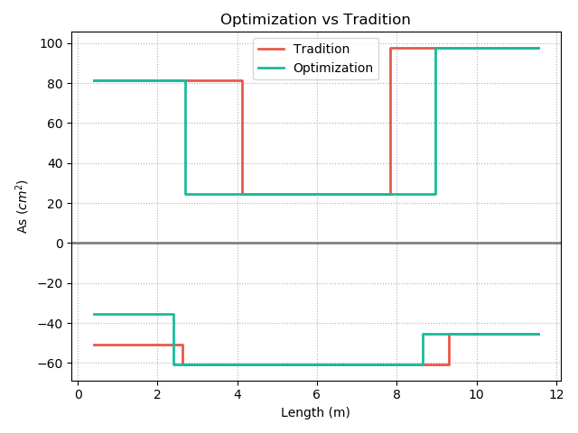
Top
12-#10
10-#10
REDUCE REBAR
3-#10
7-#8
9-#8
12-#8
Real
Demand
Bottom
Notes:
用最有感覺的圖

Slide 4
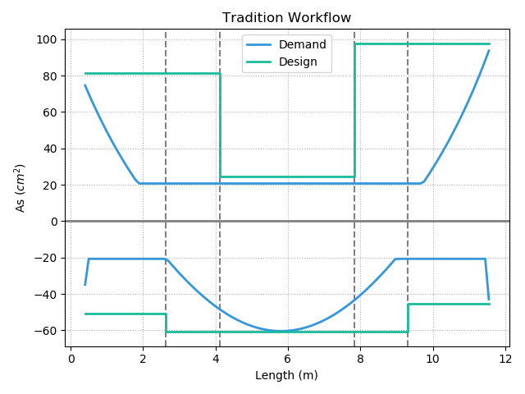
12-#10
10-#10
Today’s Solution
Fixed Bar-Cut
3-#10
10-#8
9-#8
12-#8
Notes:
LowSeismic4Floor12M 0

Slide 5
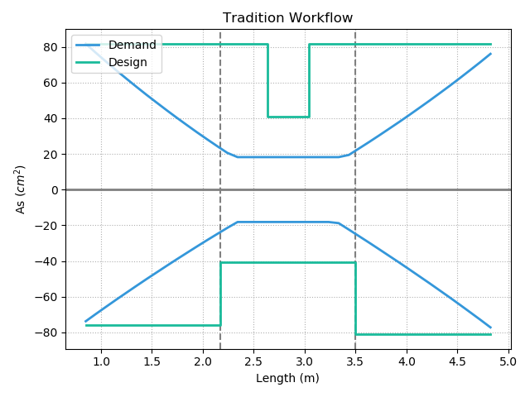
Today’s Solution
Notes:
欣銓 1140

Slide 6
Outline
Part 2
Part 4
Methodology
- Flexural
- Shear
Seismic Verification
Part 1
Part 3
Objective
Condition

Slide 7
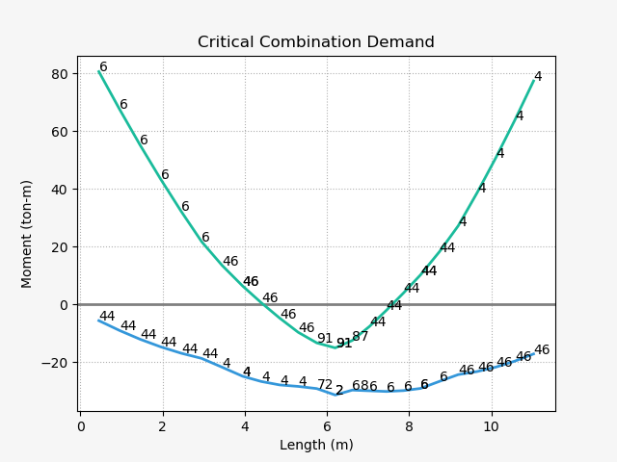
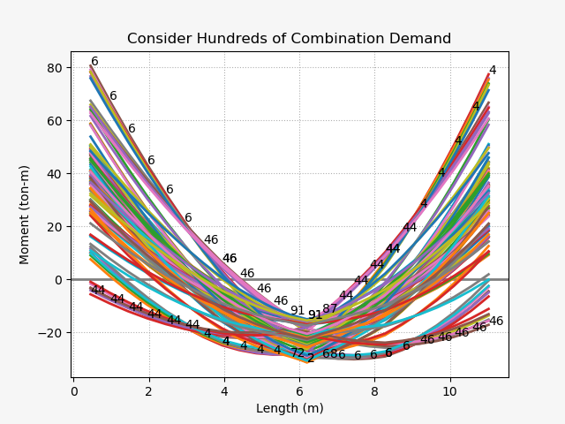
Design Moment - Mu
(1) U=1.4D
(2) U=1.2D + 1.6L
(3) U=1.2D + (1.0L or 0.5L)
(4) U=1.2D + 1.6W + (1.0L or 0.5L)
(5) U=1.2D + 1.0E + (1.0L or 0.5L)
(6) U=0.9D + 1.6W
(7) U=0.9D + 1.0E

Slide 8
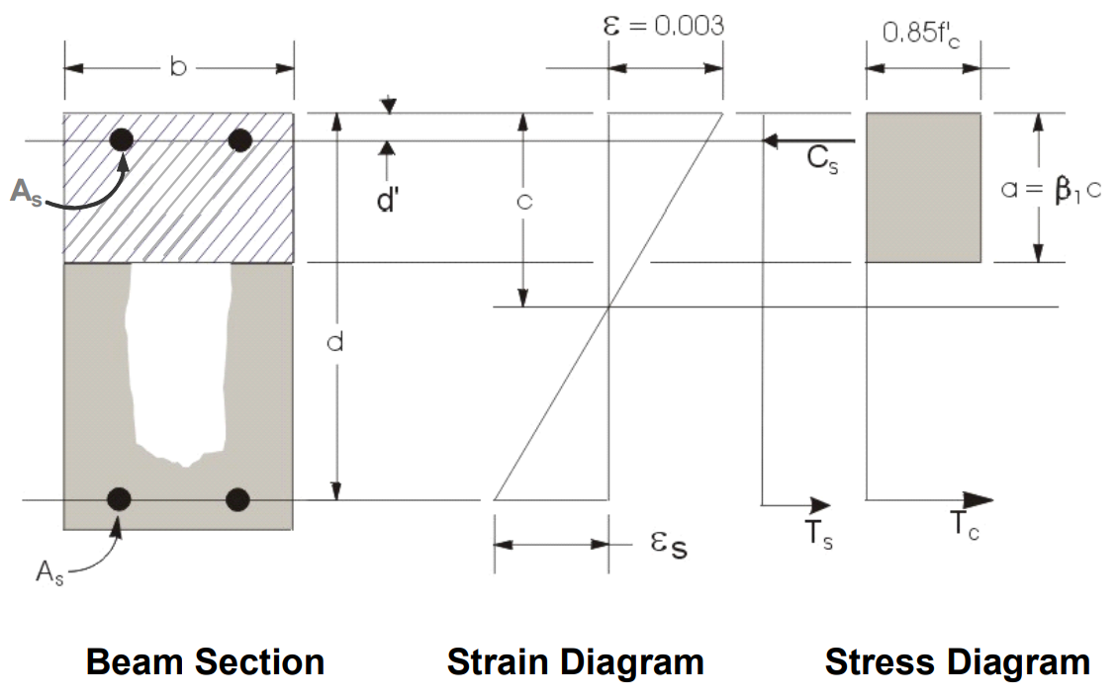
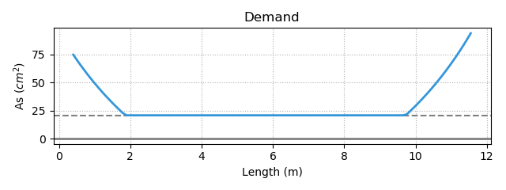
Flexural Reinforcement
- Demand As
Minimum Reinforcement
Notes:
LowSeismic 4Floor 12M 0

Slide 9
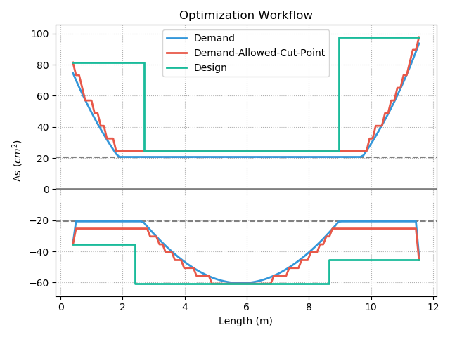
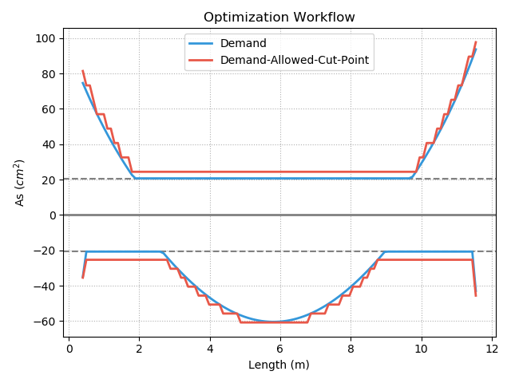
Procedure A – Effect

Slide 10
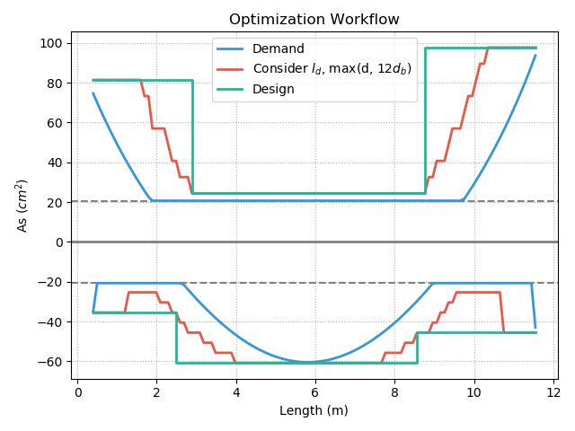
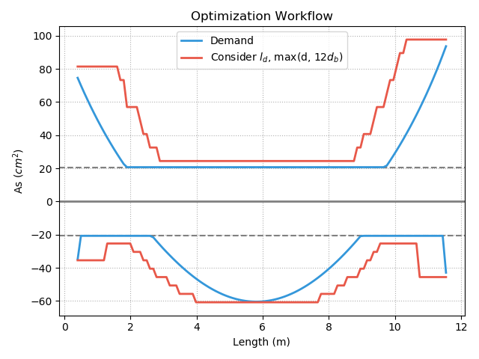
Procedure B - Fast

Slide 11
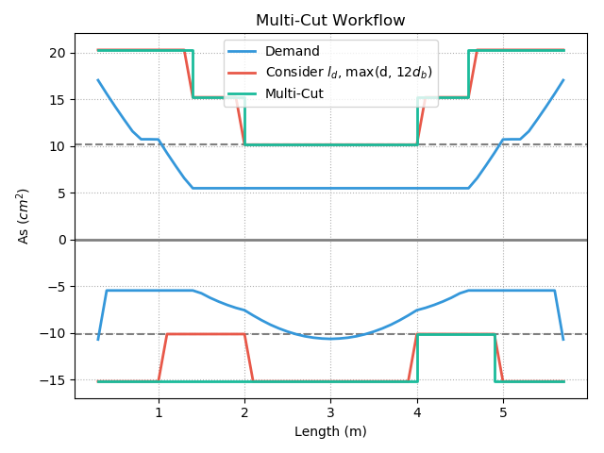
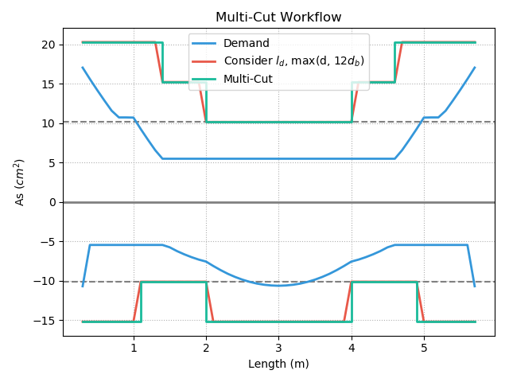
Multi-Cut
Top
Multi-Cut-4
Multi-Cut-2
Bottom
Notes:
GA 演算法
LowSeismic 4Floor 12M 4
LowSeismic 4Floor 12M 0

Slide 12
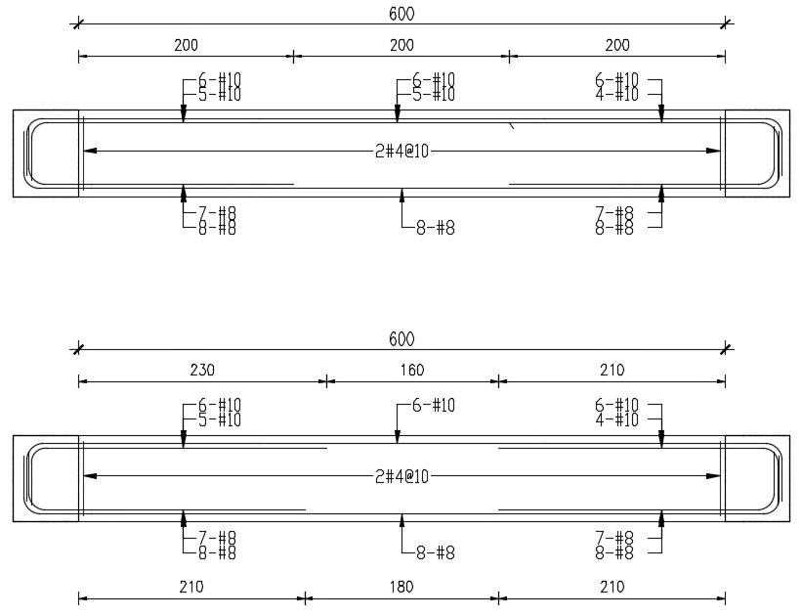
傳統梁鋼筋配置圖
最佳化梁鋼筋配置示意圖
Notes:
同第三頁的圖

Slide 13


Slide 14
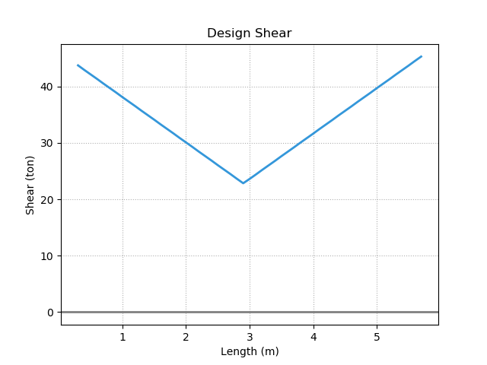
Design Shear - Vu
Notes:
LowSeismic4Floor12M 0

Slide 15
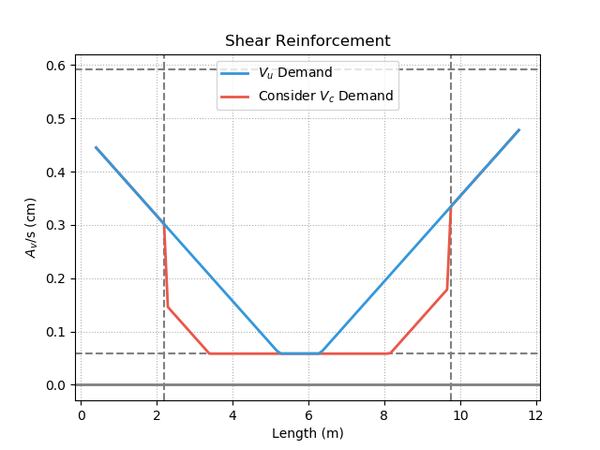
Shear Reinforcement
5.11.5
Notes:
LowSeismic4Floor12M 0

Slide 16
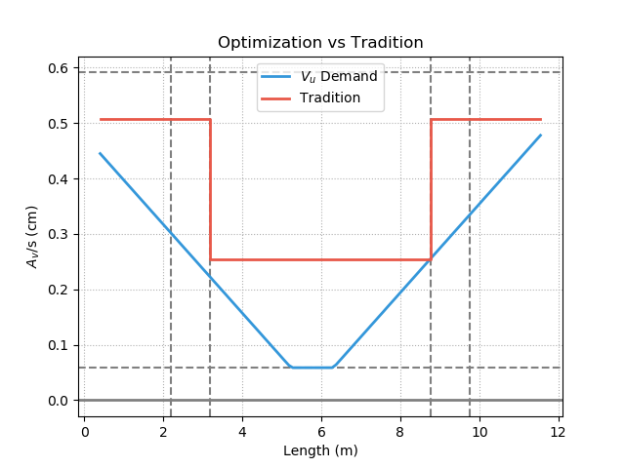
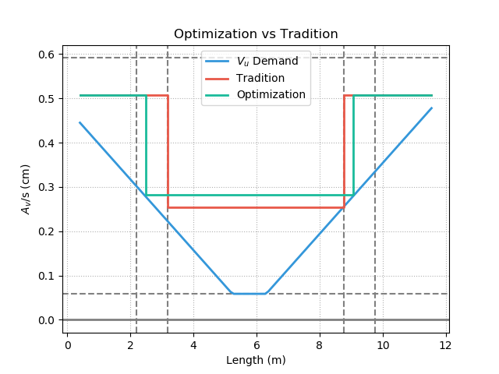
Shear Reinforcement
Notes:
LowSeismic4Floor12M 0

Slide 17
Outline
Part 2
Part 4
Methodology
Seismic Verification
Part 1
Part 3
Objective
Condition

Slide 18
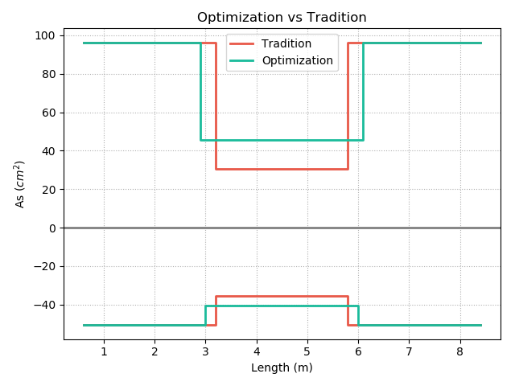
Optimization vs Tradition
12-#10
19-#8
19-#8
10-#10
3-#10
78%
6-#8
102%
94%
103%
7-#8
9-#8
7-#8
12-#8
10-#8
10-#8
Notes:
同第3頁

Slide 19
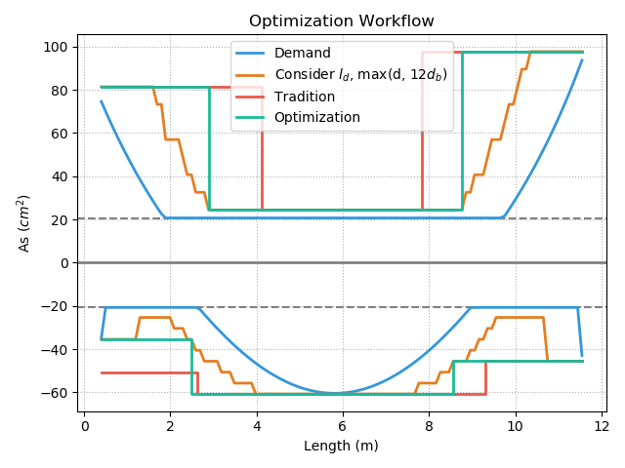
Factors
Moment
Tradition

Slide 20
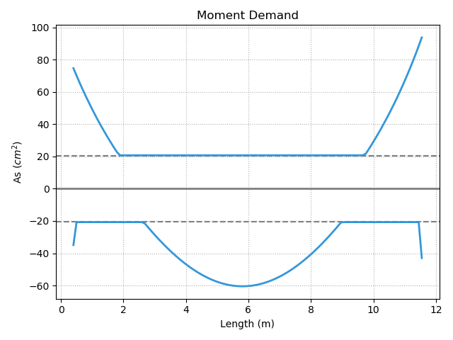
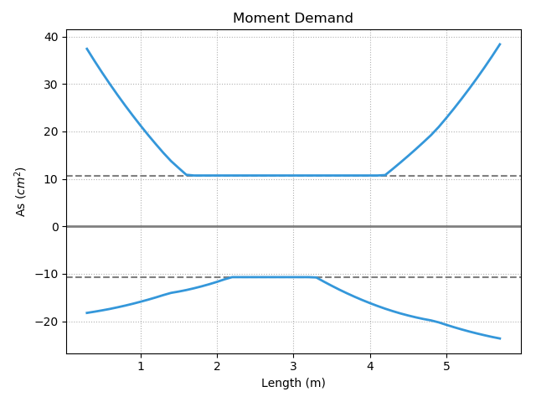
Moment Slope Large
Large Slope
Small Slope
Notes:
LowSeismic4Floor12M 0

Slide 21
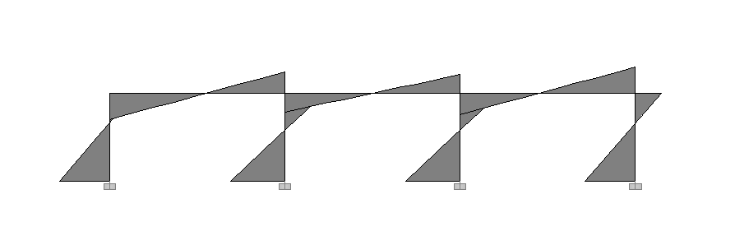
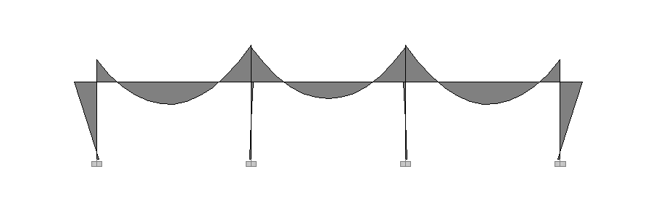
Lateral Load
Small Slope
Large Slope
Moment Diagram
Gravity Load

Slide 22
Moment Slope Large
Large Slope

Slide 23
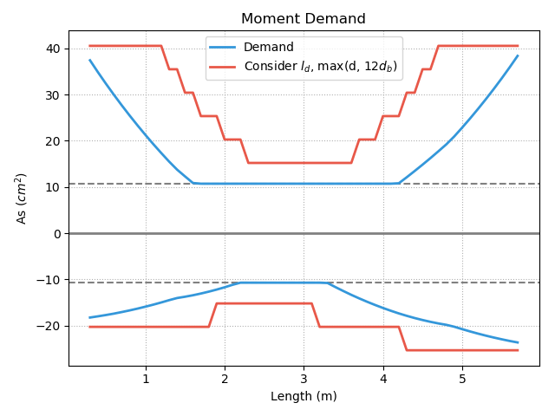
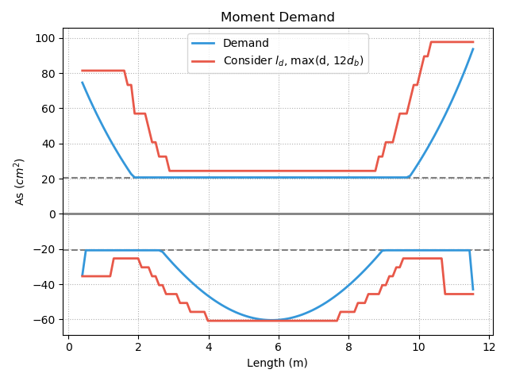
Short
Development Length
Notes:
LowSeismic4Floor12M 0

Slide 24
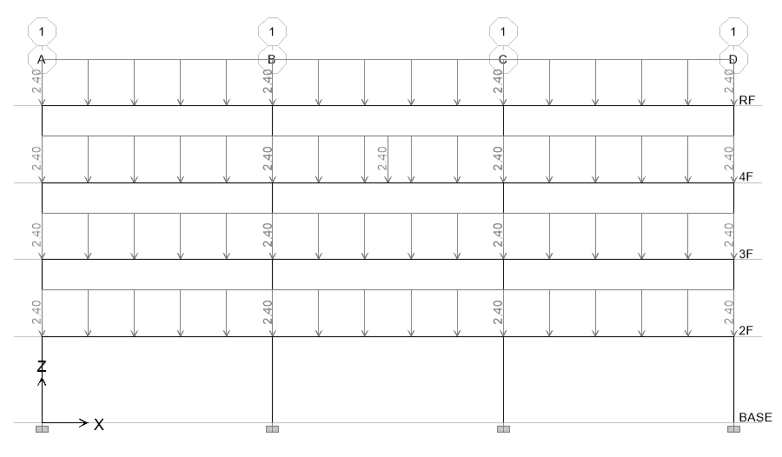
20 Models
4m
4.5m
Notes:
LowSeismic4Floor12M 0

Slide 25
Top Reinforcement

Slide 26
Bottom Reinforcement

Slide 27
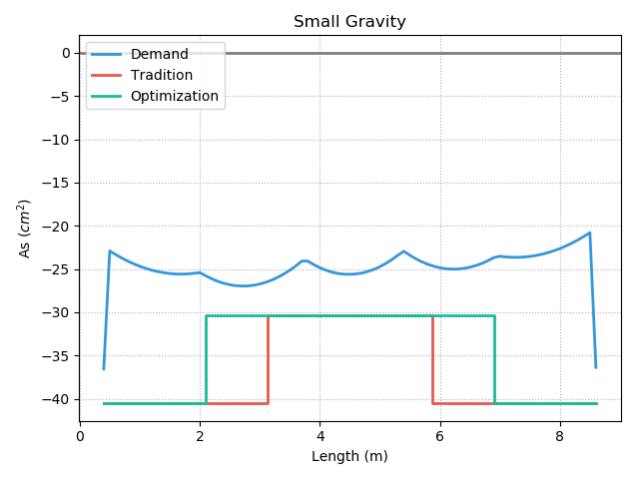
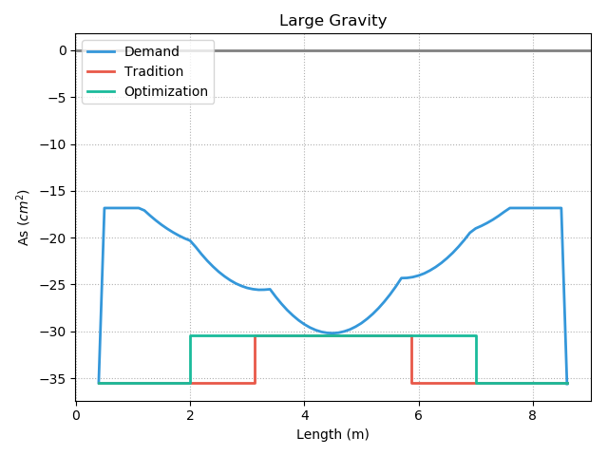
Middle Less Than End
7%
6-#8
7%
8-#8
8-#8
7-#8
4%
6-#8
4%
7-#8

Slide 28
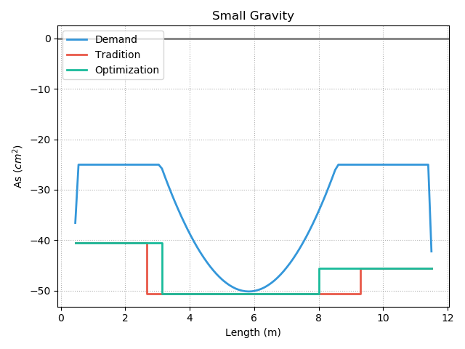
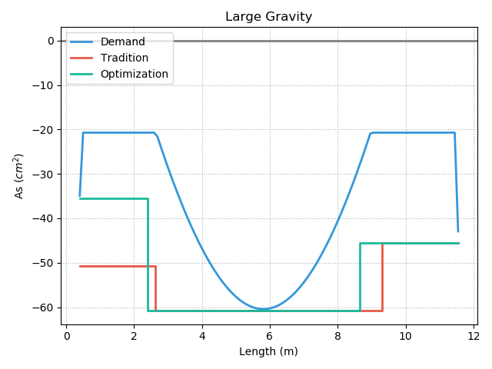
Middle More Than End
7-#8
6%
8-#8
10-#8
9-#8
12-#8
9-#8
2%

Slide 29
Total Reinforcement

Slide 30
#8 => #10 Reinforcement

Slide 31
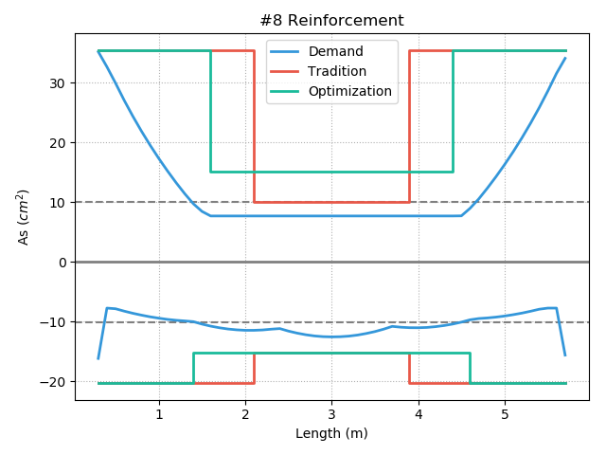
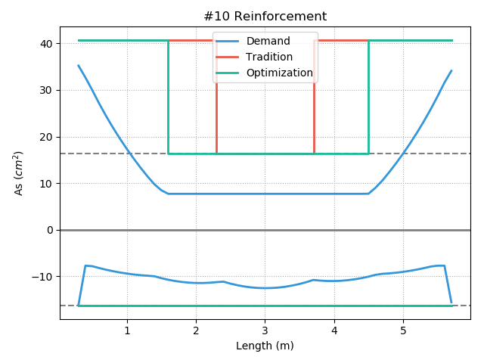
Tradition Increase
13%
13%
7%

Slide 32
Different Stories Reinforcement

Slide 34
Shear Reinforcement

Slide 35
Notes:
LowSeismic 4Floor 12M 0

Slide 36
More Multi-Cut
2
3
4
5
Unlimited
Notes:
理論最佳解

Slide 37
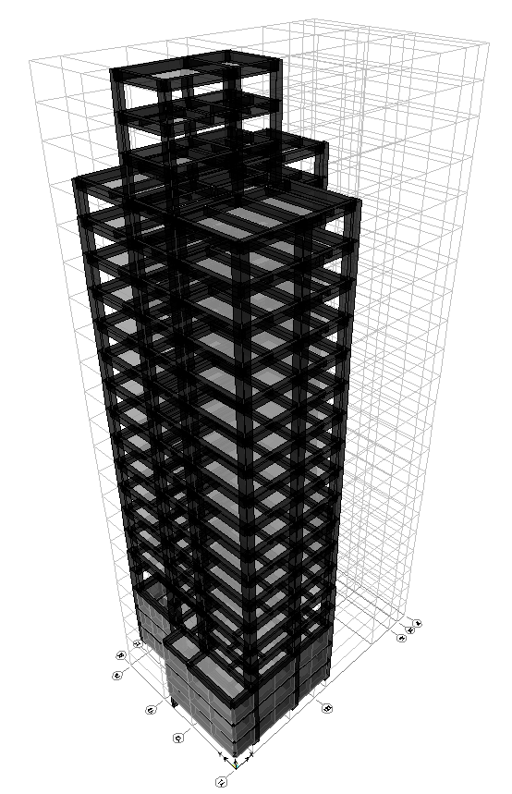
台北住宅案
100.0%
OVERALL RESULT
14F B3
101.3%
TOP RESULT
98.5%
BOT RESULT
20m
30m
Notes:
由於很複雜，先記得最終的結果
400

Slide 38
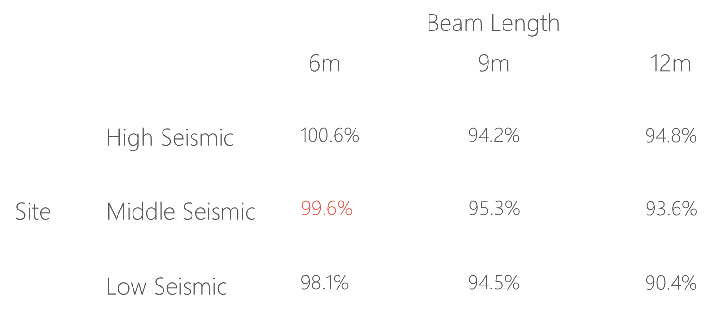
台北住宅案

Slide 39
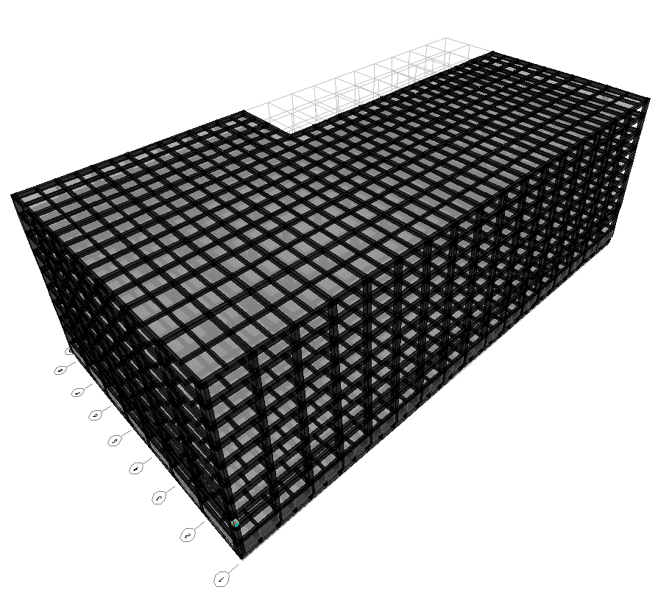
9F B1
93.4%
OVERALL RESULT
92.3%
TOP RESULT
153m
77m
94.7%
BOT RESULT
高雄物流中心
Notes:
3500

Slide 40
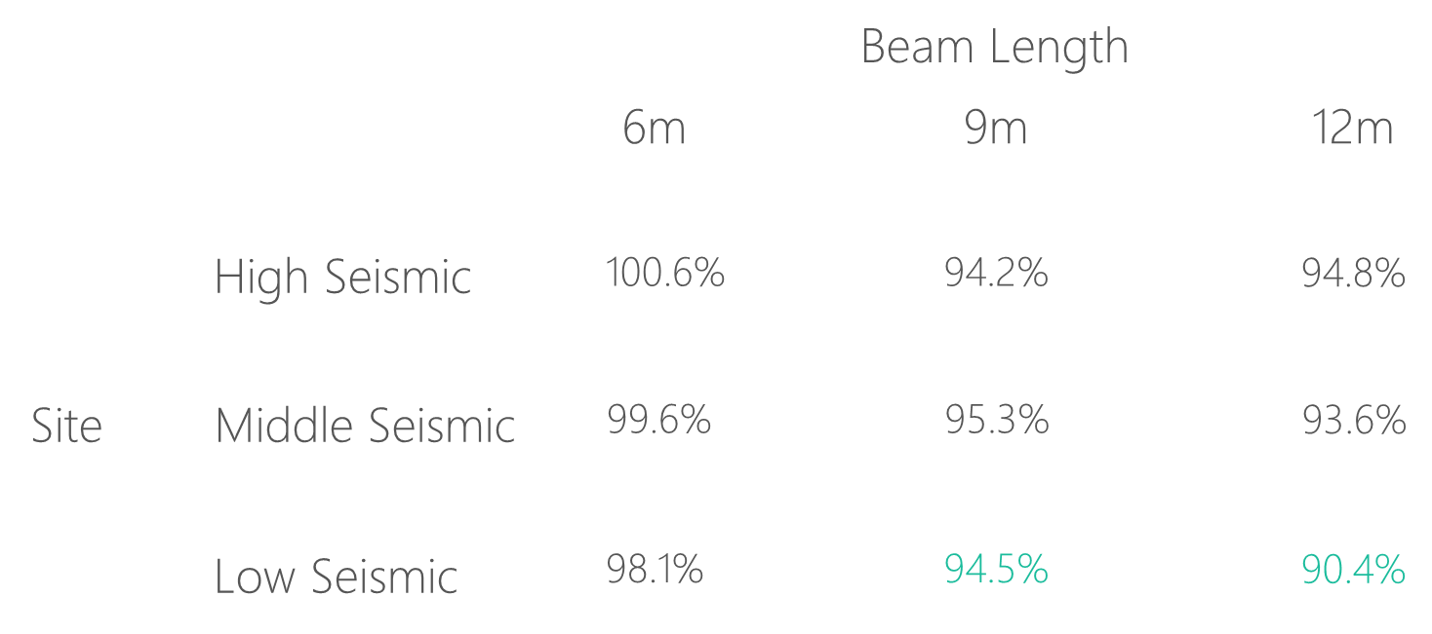
高雄物流中心

Slide 41
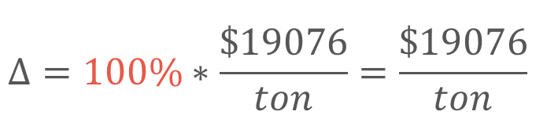
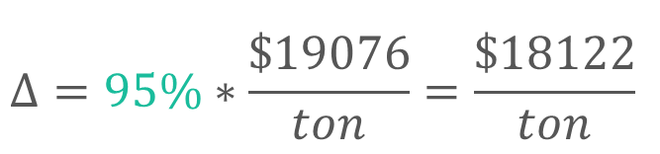
Material Cost
Tradition
Multi-Cut
$$Δ=100\%∗\frac{\$19076}{ton}=\frac{\$19076}{ton}$$
$$Δ=95\%∗\frac{\$19076}{ton}=\frac{\$18122}{ton}$$
Material Cost
Reduced Percentage
資料來源: 公共工程價格資料庫 2019

Slide 42
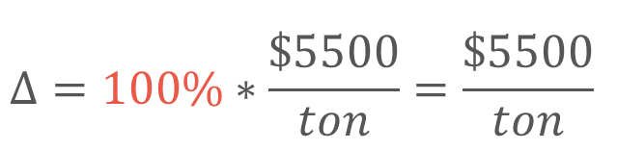
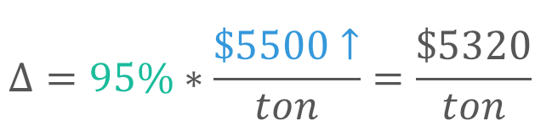
Construction Cost
Tradition
Multi-Cut
$$Δ=100\%∗\frac{\$5500}{ton}=\frac{\$5500}{ton}$$
$$Δ=95\%∗\frac{\$5500↑}{ton}=\frac{\$5320}{ton}$$
鋼筋綁紮工資
複雜度增加 => 鋼筋綁紮工資增加
資料來源: 台北市公共工程 2019

Slide 43

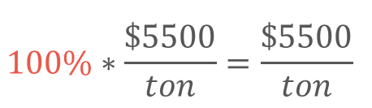

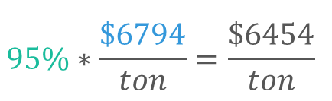
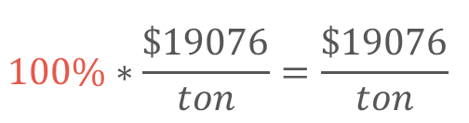
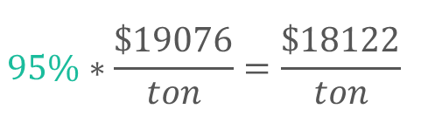
Cost Analysis
Tradition
Multi-Cut
$$100\%∗\frac{\$19076}{ton}=\frac{\$19076}{ton}$$
$$95\%∗\frac{\$19076}{ton}=\frac{\$18122}{ton}$$
Material Cost
Construction Cost
$$100\%∗\frac{\$5500}{ton}=\frac{\$5500}{ton}$$
$$95\%∗\frac{\$6794}{ton}=\frac{\$6454}{ton}$$
Total Cost
$$100\%$$
$$100\%$$

Slide 44
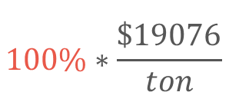

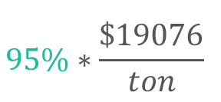
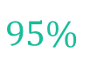
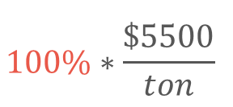
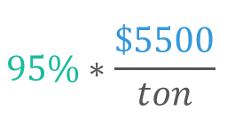
Cost Analysis
Multi-Cut-2
Tradition
Multi-Cut-2
$$100\%∗\frac{\$19076}{ton}$$
$$95\%∗\frac{\$19076}{ton}$$
Material Cost
Construction Cost
$$100\%∗\frac{\$5500}{ton}$$
$$95\%∗\frac{\$5500}{ton}$$
Total Cost
$$100\%$$
$$95\%$$

Slide 45
Outline
Part 2
Part 4
Methodology
Seismic Verification
Part 1
Part 3
Objective
Condition

Slide 46


12-#10
Consider Ld
12-#10
10-#10
10-#10
Top
3-#10
3-#10
7-#8
7-#8
9-#8
Bottom
9-#8
12-#8
12-#8

Slide 47


Pushover Method
ATC-40 Capacity Spectrum
Modal Pushover Analysis
Multi-Modes Combination
Mode Shape
Effective Mass
SRSS
Notes:
定義非線性驗證的邊界

Slide 48
ATC-40 Capacity Spectrum
Tradition
Multi-Cut-2
Notes:
Low Seismic 12m 90.4%

Slide 49
Modal Pushover Analysis - Tradition
Mode 1
Mode 2

Slide 50
Modal Pushover Analysis – Multi-Cut
Mode 1
Mode 2

Slide 51
Modal Pushover Analysis - SRSS
Tradition
Multi-Cut-2

Slide 52
Multi-Modes Combination
Tradition
Multi-Cut-2

Slide 53




Step 2
Step 3
Step 5
Step 7

Slide 54
Gravity Load
Forth Hinge
Gravity Load
+
Lateral Load

Slide 55



Without Gravity Load
First Hinge

Slide 56

Time History Analysis
Story Drift
Scaled to DBE, MCE
- Time History Spectrum
- DBE Spectrum
- MCE Spectrum
DBE < 1.5%
MCE < 2%

Slide 57


DBE < 1.5%
Low Seismic 12m 90.4%
Tradition
Multi-Cut-2

Slide 58


MCE < 2.0%
Low Seismic 12m 90.4%
Tradition
Multi-Cut-2

Slide 59




Tradition DBE
Multi-Cut-2 DBE
換圖
Tradition MCE
Multi-Cut-2 MCE
Notes:
DBE 1602 11.5
MCE 1116 15.5

Slide 60





Slide 61


Incremental Dynamic Analysis
Single Static Analysis
➔
Incremental SPO
Single Time History Analysis
➔
Incremental One

Slide 62

Non-Linear SPO
Elastic
➔
Match
Non-Negative
➔
Equal Displacement
Negative
➔
Softening

Slide 63

Pushover and IDA too much difference

Slide 64


Another way IM: Base Shear

Slide 65
SF: 0.5
SF: 2.5
SF: 4.5
SF: 6.5
SF: 8.5
SF: 10

Slide 66

Result

Slide 67


Limit-State
4% FEMA273
2.5% SEAOC2000

Slide 68


IDA
Low Seismic 12m 90.4%
Log

Slide 69
Conclusion
Condition
Verification
Long Span
Low Seismic
Capacity Close To Tradition
Objective
Construction
Reduce Rebar
Today or Future Cost

Slide 70
Roadmap
02/2016
04/2016
06/2016
Market Overview
Pre-Release
Launch
01/2016
03/2016
05/2016
Introduction
Partnerships
Beta

Slide 71





Mu
Consider Hundreds Of Combo Demand
Critical Demand Combo
$$A_{s}({cm}^{2})$$
$$A_{s}({cm}^{2})$$
Length(m)
Length(m)

Slide 72


Design Moment - Mu
(1) U=1.4D
(2) U=1.2D + 1.6L
(3) U=1.2D + (1.0L or 0.5L)
(4) U=1.2D + 1.6W + (1.0L or 0.5L)
(5) U=1.2D + 1.0E + (1.0L or 0.5L)
(6) U=0.9D + 1.6W
(7) U=0.9D + 1.0E

Slide 73


Design Moment - Mu
(1) U=1.4D
(2) U=1.2D + 1.6L
(3) U=1.2D + (1.0L or 0.5L)
(4) U=1.2D + 1.6W + (1.0L or 0.5L)
(5) U=1.2D + 1.0E + (1.0L or 0.5L)
(6) U=0.9D + 1.6W
(7) U=0.9D + 1.0E

Slide 74




General Development Length Equation
Procedure A
MIN
Simplified Provisions

Slide 75
General Development Length Equation
Procedure A
MIN
Simplified Provisions

Slide 76

傳統梁鋼筋配置圖
最佳化梁鋼筋配置示意圖
Notes:
LowSeismic 4Floor 12M 0

